Slide 1
CGCS Agenda- Friday, April 16 @ 1pm
via Zoom: https://umsystem.zoom.us/j/99434052164?pwd=cFM4elZzT3R1ZE4yWTIyOVVOTmpVUT09
Graduate Catalog Updates
Grad Track Pathways Update
How to Track Prospective Students and Their Intent to Enroll (Discussion)
Form 1 Due Date
Technical Editing Stats
Thesis/Dissertation Format Checking Numbers
Fellowship Poster Session
Spring 2021 Events
Reminders, Deadlines & Announcements

Slide 2
Graduate Catalog Updates
1st round of edits were due to the Registrar’s Office by April 2, 2021
2nd round of edits typically due by mid-May

Slide 3
Grad Track Pathways Update
Graduate Council Meeting April 7, 2021
  Proposal to adjust the deadline for admittance to the GTP be recommended to be no later than thirty days prior to the semester or session that the student completes the undergraduate degree.
  Approved and will be for final vote at the May Graduate Faculty meeting.

Slide 4
How to Track Prospective Students and Their Intent to Enroll (Discussion)
How do programs track students between when the are sent an acceptance letter and actually getting a commitment decision to the program, especially for a non-thesis master student without funding (e.g., funding contracts, assistantships, etc.)? Is there a tracking system the university uses to notify the program if a student intends to enroll?

Slide 5
Form 1 Due Date
Impact of Form 1 in the 9th credit hour (1st semester for most students)
  Conditional admission to the master’s degree
  Admission with probationary status

Slide 6
Technical Editing Stats – March 17-April 12
Total Papers: 11
  Articles: 8
  Conference Papers: 2
  Dissertations: 1
  Theses: 0
Total Pages: 199
Total One-on-One Meetings with Students: 6
Served 8 students from 7 departments.
  Mining: 1
  Nuclear: 1
  Electrical and Computer: 2
  Civil, Arch, and Environ: 1
  Mechanical and Aero: 1
  Chemical: 1
  Materials: 1

Slide 7
Thesis/Dissertation Format Checking Numbers
There have been 62 theses/dissertations submitted for format checking SP2021
  37 dissertations
  25 theses

Slide 8
Fellowship Poster Session during
Let’s Talk Research!
Chancellor’s Distinguished Fellows will participate in the Fellowship Poster Session during Let’s Talk Research!
  Friday, March 26 @ 3pm
  Friday, April 30 @ 3pm
    Zoom link: https://umsystem.zoom.us/j/94649132172?pwd=RVdtNmVkdWRkM2ZlZUU3aC9KVlpBdz09
    Passcode: 303130

Slide 9
Fellowship Poster Session
April 30:
  Christopher Hogan, Mathematics
    Green's Function Methods and the Nonhomogeneous Wave Equation
  Nicole Moon, Chemistry
    Construction and Demonstration of a Microwave Three-Wave Mixing Spectrometer at Missouri S&T
  Alexander Douglas, Mining Engineering
    Big Data: Innovation in Haul Road Maintenance
  Samuel Vanfossan, Systems Engineering
    Disaster Recovery Strategy Generation via Multi-Objective Heuristic Optimization
  Daniel Bowerman, Mathematics
    Nonstandard Methods Applied to the AIM Conjecture
  Cesar Ortiz Rios, Materials Science and Engineering
    Microscale Residual Stress in Aerospace Alloys
  John Tubbesing, Chemistry
    Chiral Crystallization and Epitaxial Materials

Slide 10
April & May 2021 Events
Editing for Yourself Workshop
  Monday, April 19th @ 12pm
  https://umsystem.zoom.us/j/95538552190?pwd=elJzNjAyb0c1dGR4K1dEOTd6Z3hqdz09
  Meeting ID: 955 3855 2190
  Passcode: 912359
Working with Industry Workshop
  Fri, April 23rd @ 3-5pm
  https://umsystem.zoom.us/j/99189327523...
  Meeting ID: 991 8932 7523
  Passcode: 500600
We Dig Research! – Grad Students Invited!
  Fri, April 9 @ 3pm
  Fri, May 14 @ 3pm
  Zoom link
  Passcode: 641260

Slide 11
Additional Resources
Pre-Recorded Short Workshops:
How to Write an Abstract
How to Write an Acknowledgement
Writer’s Block
Recorded Full Workshops from Spring 2021
Resources for GTAs
https://grad.mst.edu/events/

Slide 12
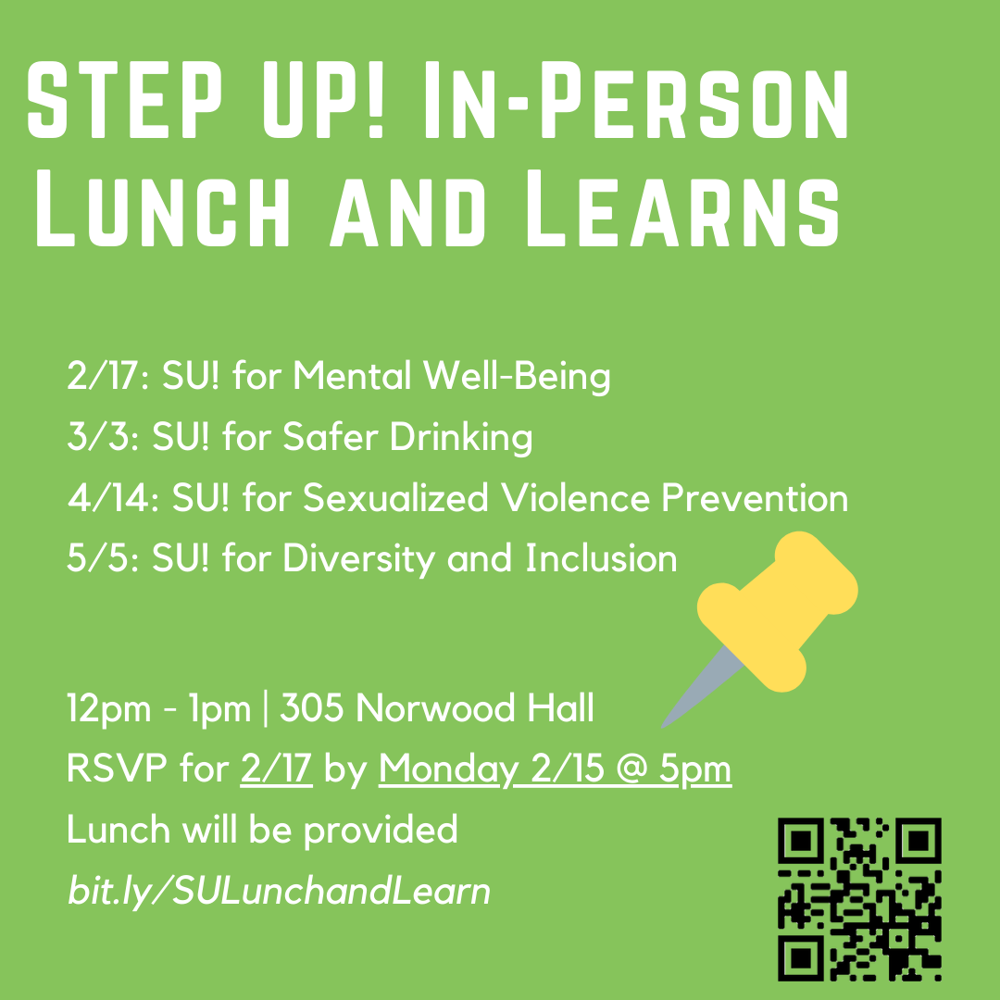
Spring 2021 Events – Out of Department
Miners for Recovery (M4R) is meeting weekly via zoom on Wednesday’s at 1pm. Email counsel@mst.edu for additional information or call 341-4211.
Explore your behaviors, reflect on ideas for change, avoid negative consequences related to drugs and alcohol, and experience the support of a safe group.
https://counseling.mst.edu/media/studentsupport/counseling/documents/Miners%20For%20Recovery%20Brochure.pdf#200821111605
Graduate Student Support Group (Hosted by Counseling Services)
  Meet with other grad students and a counselor for weekly support regarding unique challenges of grad school and other important life areas. Common topics of discussion address time management, procrastination, impostor syndrome, social anxiety, career planning/networking, mentoring/leading other students, communication/collaboration with advisors.
  Fridays, 1-2pm via Zoom
  Call 573.341.4211 to schedule a brief introductory meeting with the group leader

Slide 13
Reminders, Deadlines & Announcements
May 14 – Results of Non-Thesis Master of Science Comprehensive Exam (only applies to Chemistry and AE Biology programs)
Final Semester Deadlines
If you have an announcement/event that you would like for us to promote for you on our social media sites or in the weekly email to graduate students, please forward it to Lea Hickerson (lphr29@mst.edu)

Slide 14
Thank you!
See you this fall!

